Slide 1
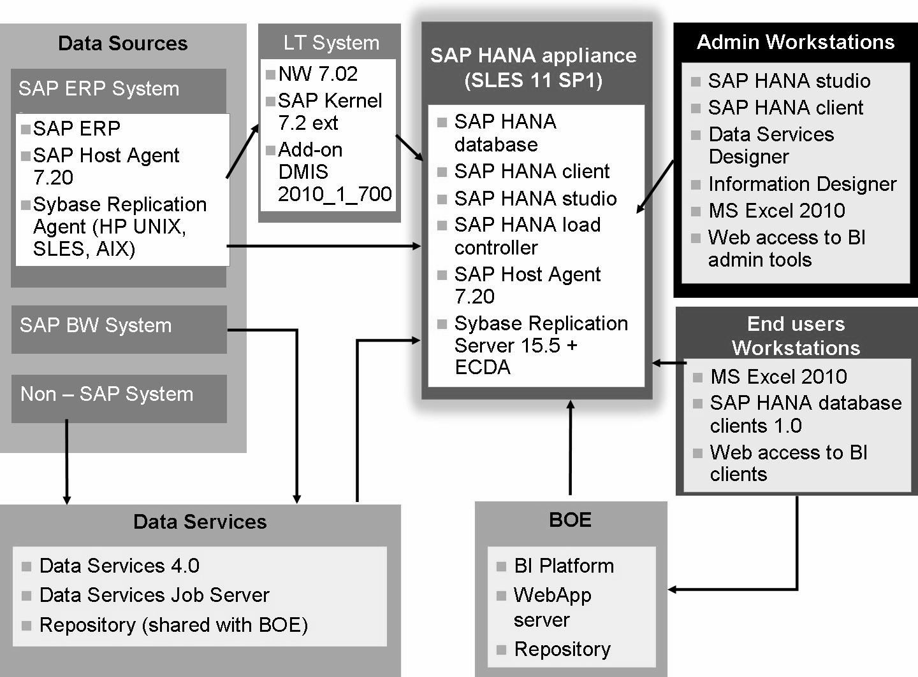
SAP HANA System Landscape

Slide 2
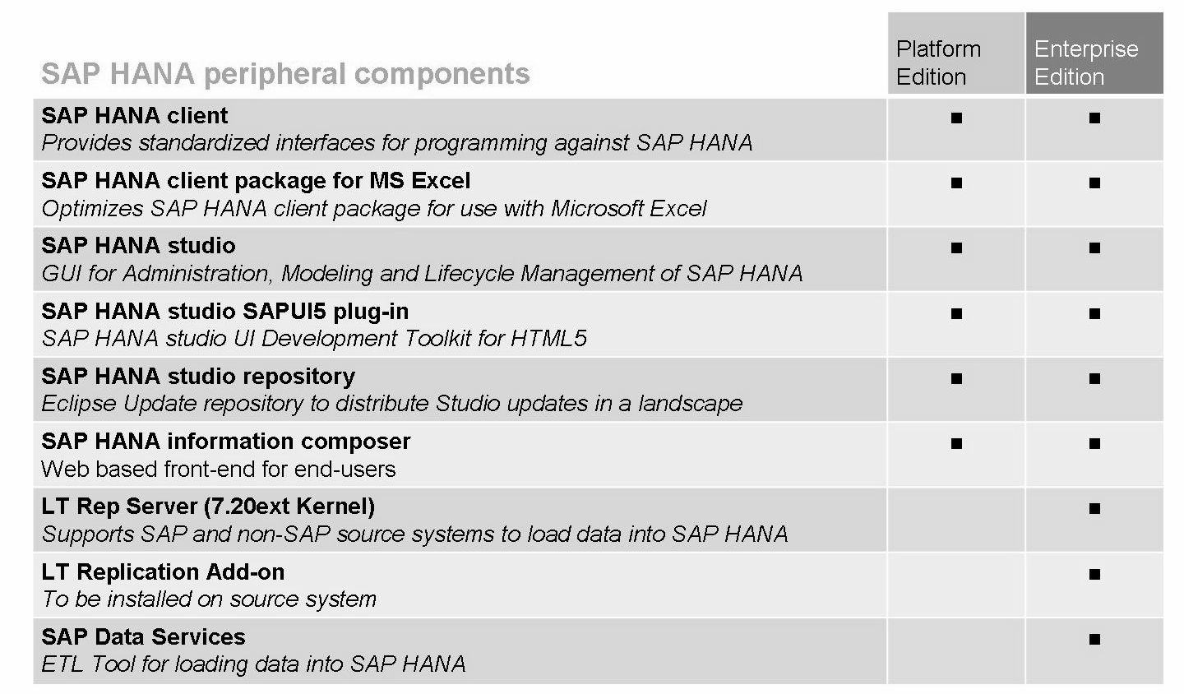
SAP HANA peripheral components

Slide 3
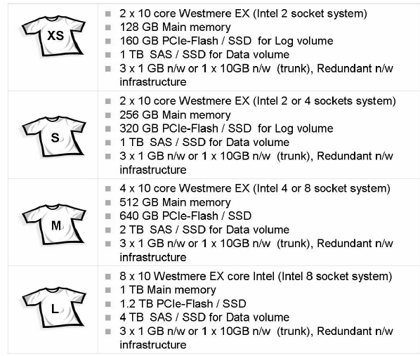
Server Sizing
$60,000 – 75,000
$85,000 – 125,000
Price is exclusive of installation cost

Slide 4
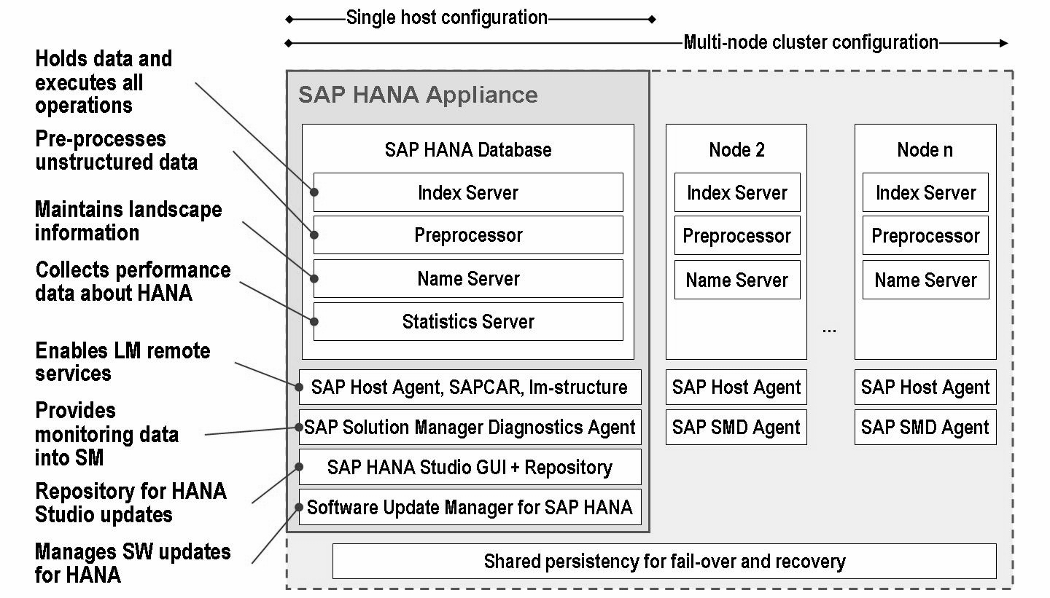
System Architecture

Slide 5
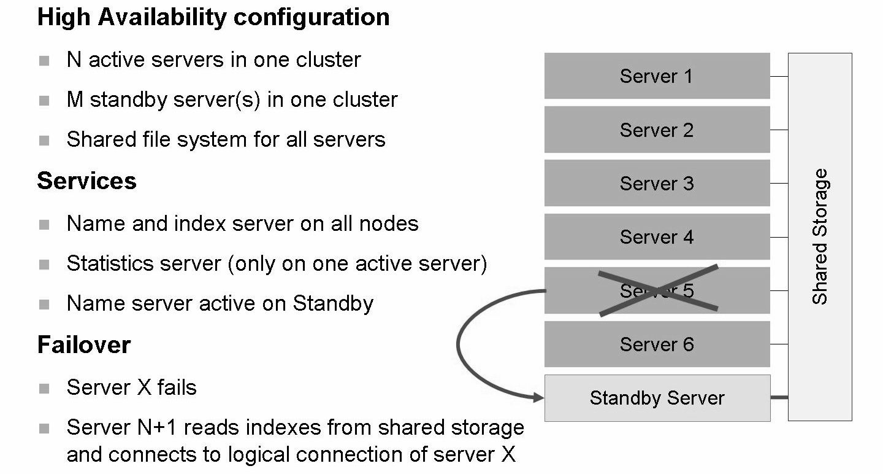
Scale Out - High Availability

Slide 6
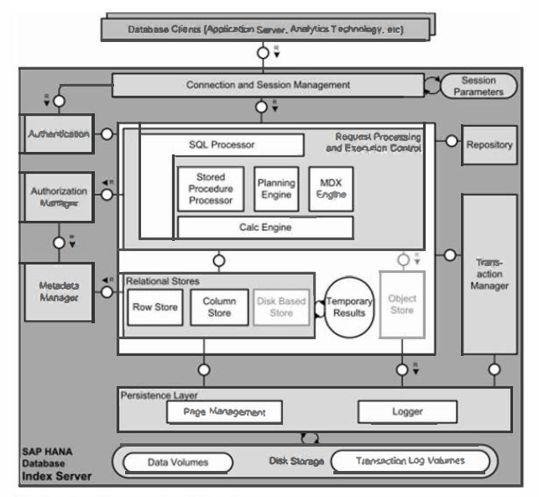

Slide 7
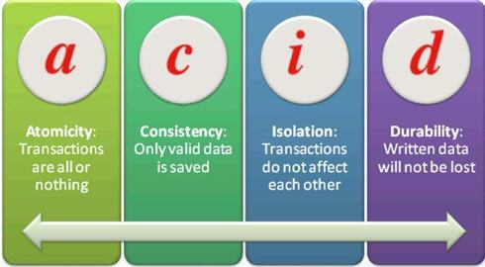
ACID - a set of properties that guarantee that database transactions are processed reliably.

Slide 8
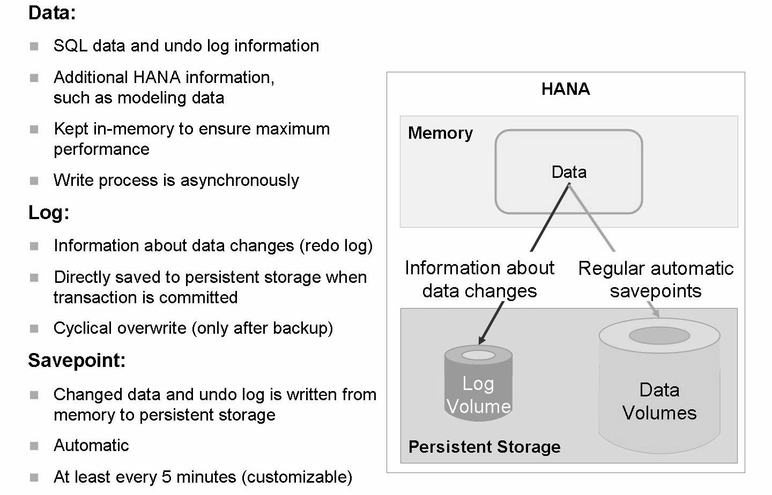
Persistence Layer

Slide 9
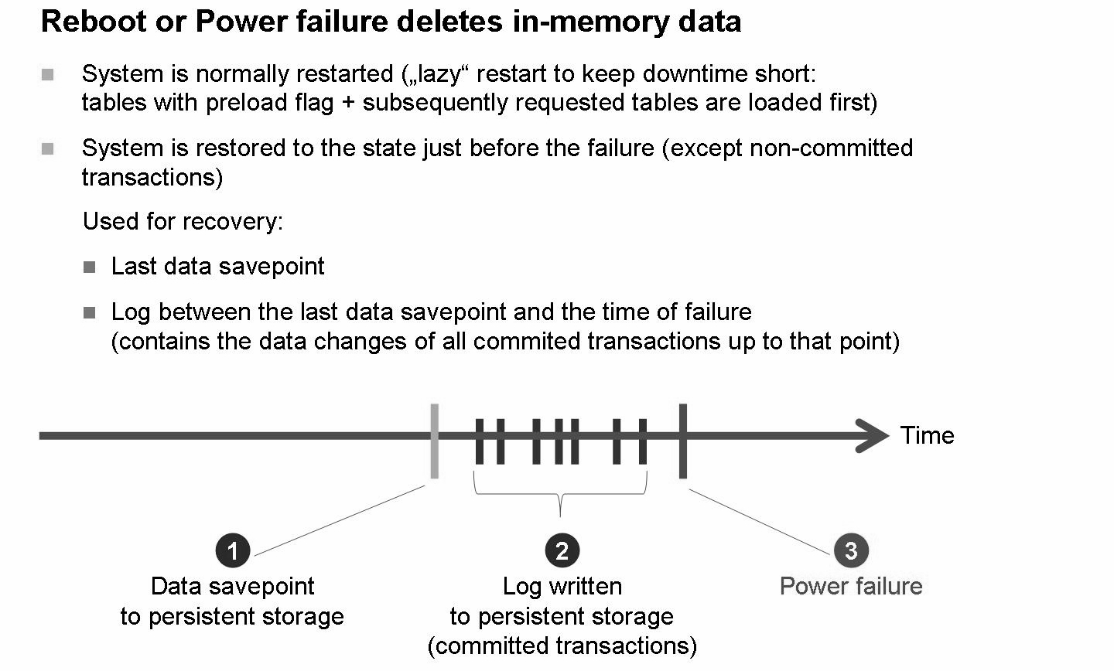

Slide 10
THANK YOU

